Slide 1
ANLP – Final Project Presentation
Review Digest
An “all-you-want-to-know” snippet, in an easy to understand format, for an item you want to buy.
Team Members
Richa Keshav Ankur

Slide 2
When we last met

Slide 3
Project Goals
What are we trying to accomplish ?
Help the poor souls who have to go through hundreds of reviews before making sure if they want to buy an item or not.
Why are we trying to do this ?
Because everyone will love to have this.

Slide 4
Here is what we originally meant to accomplish

Slide 5
Improving everyone’s online shopping experience

Slide 6
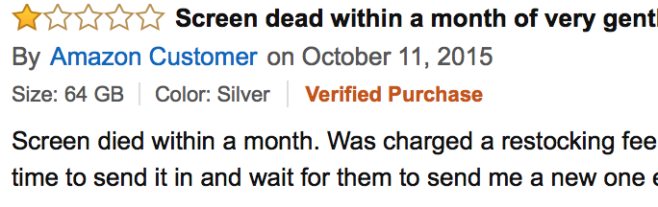
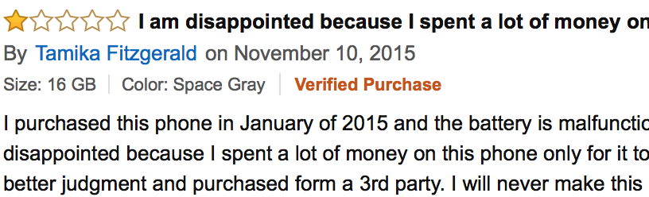
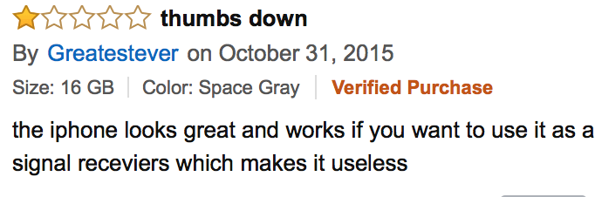
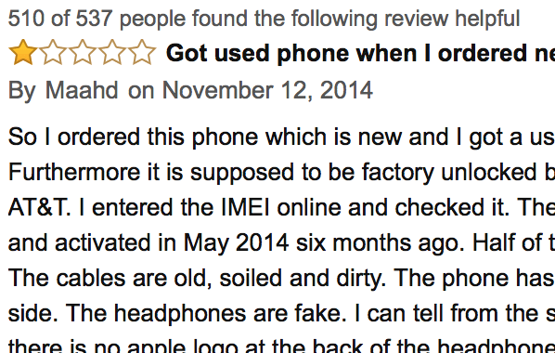
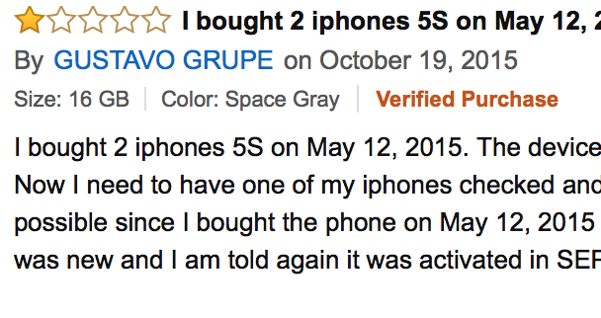
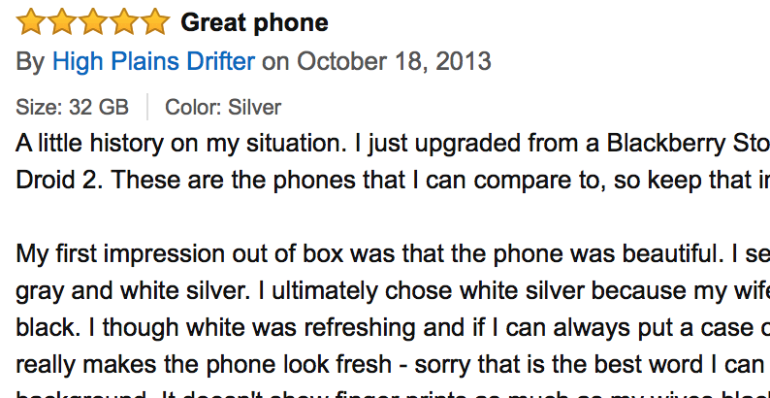
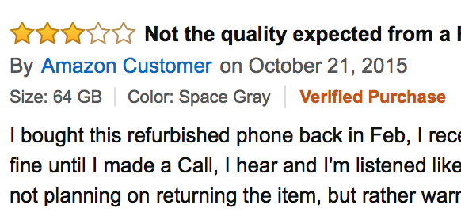
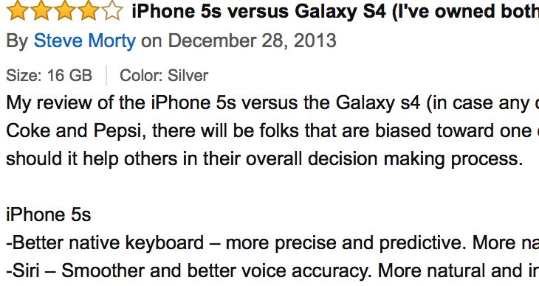
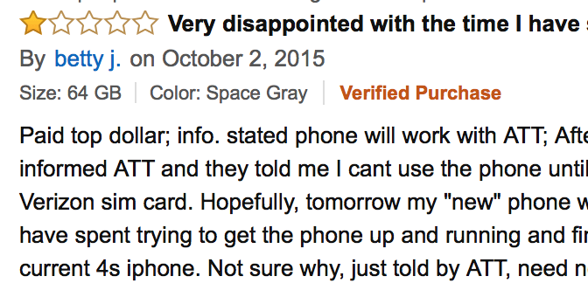
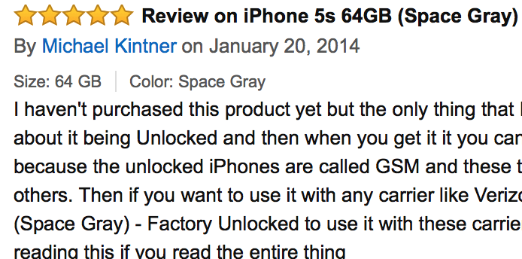

Slide 7
IPhone 5s
Summary:
- Great feel - Better than others
- Good product - Very happy with this item
Pros:
- Camera (1456 people loved the camera quality)
# Great in low light conditions (987 people said so)
- Performance (789 people appreciated the seamless performance)
- Reliability (1678 people loved the reliability)
Cons:
- Cost (1900 people said the item was too costly)
- Camera (200 people said camera was not up to the mark)
# Not as good as Samsung S4 (1 person said so)

Slide 8
Won’t graphs be a better way to represent what users are saying

Slide 11
The Pathway to Success !

Slide 12
What we did ?
Cleansing and Scrubbing of web-scrapped data
Keyphrase Identification and/or Product Attribute Extraction
Mapping relevant review phrases to corresponding features
Sentiment Analysis for each feature
And finally, drawing results from the sentiments

Slide 13
Workflow

Slide 14
Step 1 – Scraping web data and initial clean-up
Create custom scripts using BeautifulSoup library in Python.
Transform data to UTF-8 from the original encoding.
Remove special Unicode characters used in the reviews.
Split reviews to individual sentences and store it in an easily accessible
format. (.xls, .csv)

Slide 15
Step 2 – Product Attribute Extraction
Challenges :
Different words and phrases to describe the same product attribute
Words describing same attribute might not be synonymous
E.g. "appearance" and "design" for ‘design’
E.g. "Apple store" and "T-Mobile" for service
Presence of frequent words not relevant to phones
E.g. "hour", "work", "expectation"
Features and descriptors in different sentences.

Slide 16
Step 2 – Product Attribute Extraction
Algorithms:
Common Words
Attribute expressions sharing some common words are likely to belong to the same group. E.g. "battery life", "battery", "battery charger" etc.
Lexical Similarity
Attribute expressions whose words are synonymous in WordNet are likely to belong in the same to the same group. E.g. "battery" and "charge"
Domain Filtering
Attribute expressions whose words are related with the application domain or product are likely to be most relevant product attributes. E.g. "screen", "internet", "camera" are essential features of a cellphone and hence relevant, and "hour", "work", "good", "simple", "expectation", "fine" etc. are not.

Slide 17
Step 2 – Product Attribute Extraction
What we couldn’t accomplish:
Identify and Capture indirect or derived product attributes like "seller", "user experience", "price", "speed " etc.
Associate words like "cheap", "expensive" or "rip off" to "price"
Identify synonyms better and club them together.
For example, "light" and "lighter" should be clubbed together, "monitor" and "display" should be clubbed together.

Slide 18
Step 3 – Extracting phrases for each Product Attribute
Challenges :
Sentences with multiple features, and corresponding descriptors.
Sentences with multiple features, and single set of descriptor.
Sentences with single feature, and multiple descriptors.
Features and descriptors in different sentences.

Slide 19
Step 3 – Extracting phrases for each Product Attribute
Algorithms:
Tagging
Creating ngram_tagger and sentence tokenizer.
Creating training data to appropriately tag Conjunction words.
Tokenizing
Using Context Free Grammar algorithm to tokenize sentences.
Using Regex parsers to tokenize sentences.
Using conjunction and other punctuations to identify single attribute phrases.
Mapping the phrases to relevant product attributes
Using attributes, and synonyms to identify which phrase to attribute mapping.

Slide 20
Step 3 – Extracting phrases for each Product Attribute
What we couldn’t accomplish:
Pronoun resolution: Mapping descriptors from different sentences to the features.
Phrases with multiple attributes associated to a single set of descriptor.

Slide 21
Step 4 – Performing Sentiment Analysis on the phrases
Challenges :
Identifying appropriate vectorizer
Selecting the best classifier
Not over-fitting the classifier on training data.

Slide 22
Step 4 – Performing Sentiment Analysis on the phrases
Algorithms:
Vectorizing
Count Vectorizer
Tf-Idf Vectorizer
Classifying
Using Logistic Regression model to classify sentences.
Using Random Forest model to classify sentences.
Using SVM model to classify sentences

Slide 23
Step 4 – Performing Sentiment Analysis on the phrases
Over-fitting problem:
Count Vectorizer +Logistic Regression classifier = 81% precision.
But results on test data were not that good.
Whereas,
Tf-Idf Vectorizer +Random Forest classifier = only 76 % precision
But Much better results on test data

Slide 24
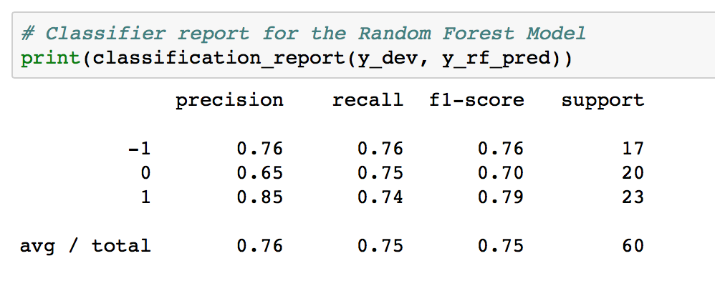
Performance of Sentiment Classifier

Slide 25
Results

Slide 26
Training / Development Data Set

Slide 27
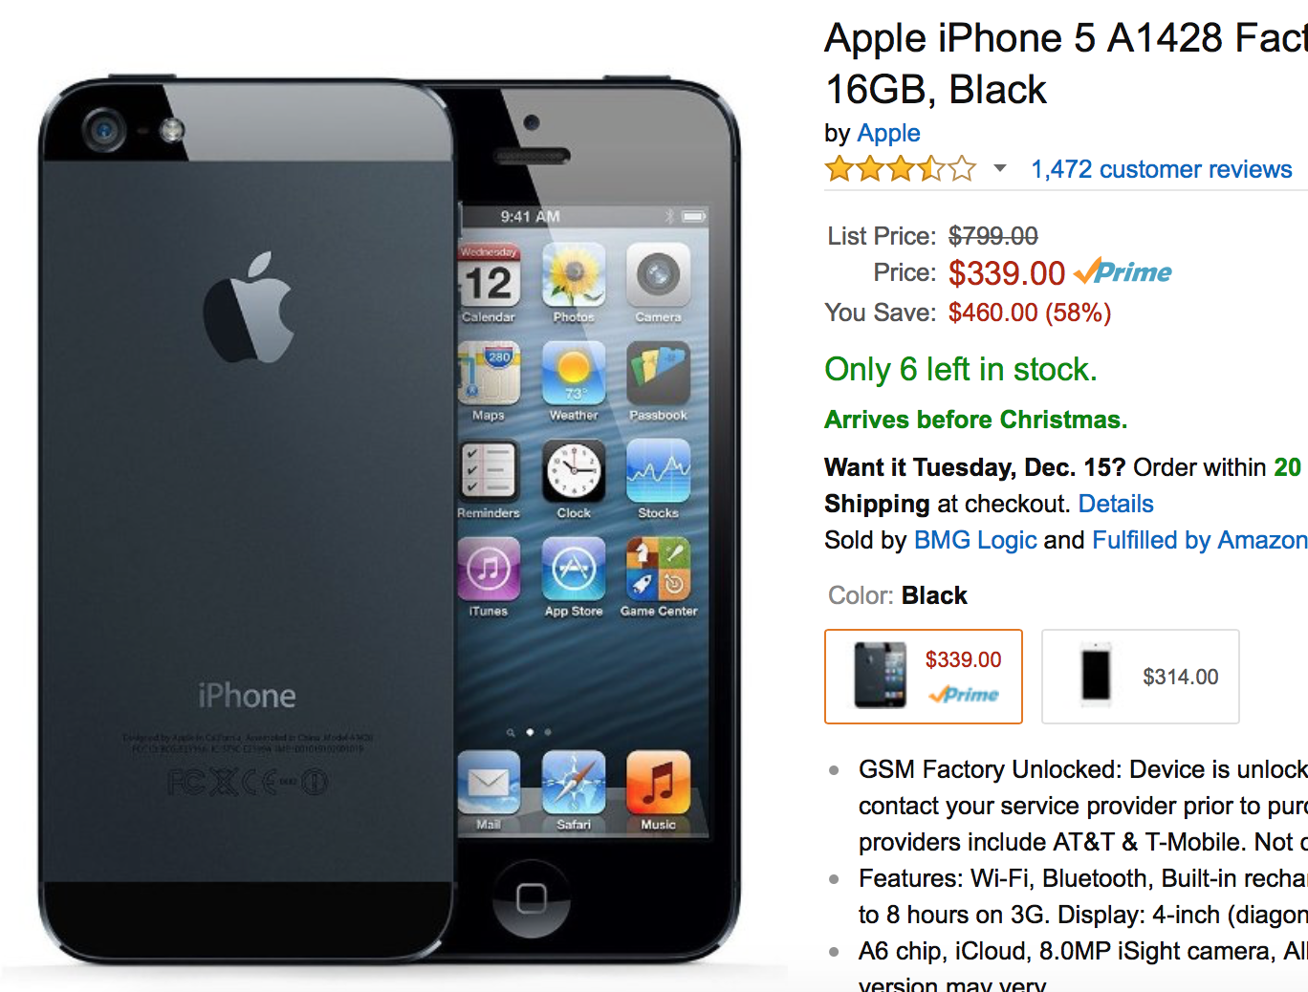
IPhone 5s – Amazon Review Data
1411 reviews
(It might have changed since then)
Manually labelled for sentiment classifier.

Slide 30
But, there was a problem with Neutral Mentions
What we found out :
That phrases corresponding to neutral mentions of any product feature were generally regarding how they were using it.
Something like :
I gifted this phone to my wife
I travel a lot with this phone, and perform many tasks on it.

Slide 31
So, no maybe’s

Slide 32
Test Data Set

Slide 33
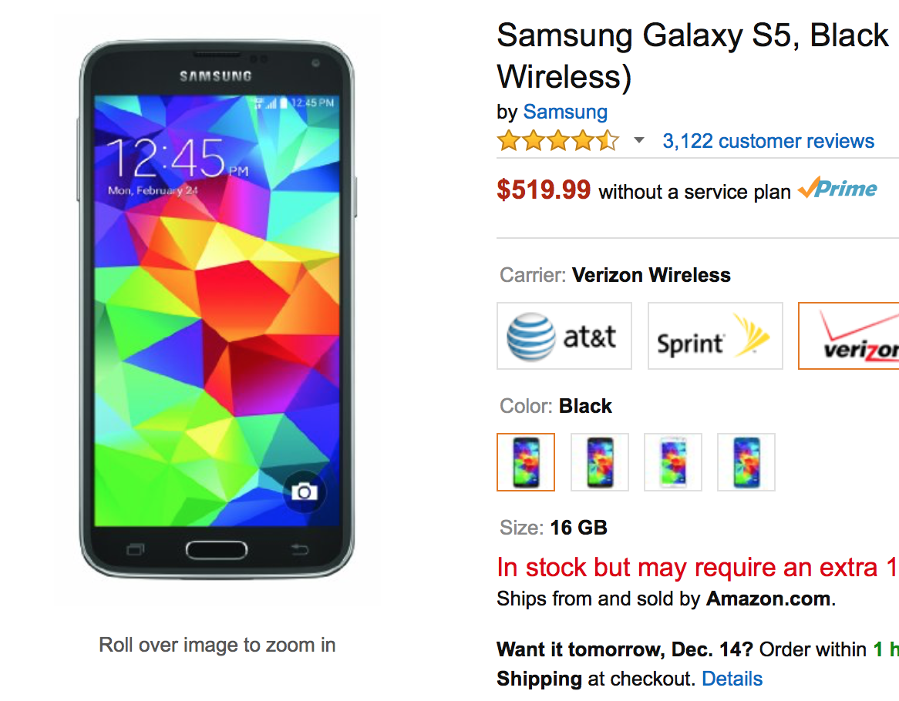
Samsung Galaxy S5 – Amazon Review Data
2880 reviews
(It might have changed since then)

Slide 36
Future Work
Better features ?
We did invest a lot of time of feature extraction, and managed to get very good results.
But, we believe there is still room for improvement in this dimension.
Code optimization
Our current code takes about 15 minutes to execute and output results.
An app or a browser plugin (Which also does product comparisons ?)
If we can reduce the execution time, and do some more adjustments to the complete algorithm, we might have a great application in our hands which can be applied to other electronic products as well.

Slide 37
That’s All ! Thank You

Slide 38
Appendix

Slide 39
Precision in Product Feature Extraction
Manual Inspection | Iphone 5s | Galaxy | Nexus
Battery | Battery | Battery | Battery
Screen | Display | Monitor, Display | Display
Charger | Charger | Charger
Speakers | Headphone
Camera | Camera | Camera | Camera
Keyboard | Button, Home | Button, Home | Home
Software | System | System
Manual Inspection | Iphone 5s | Galaxy | Nexus
Size | Light ,Lighter |  | Light ,Lighter
Connection | Connection | Wireless
Hardware | Hardware | Resistance, Sensor, Port, Scanner | Processor, Hardware
Body | Back | Back
Experience
Speed
 | Fan |  | Fan

Slide 41
Test Data Set 2

Slide 42
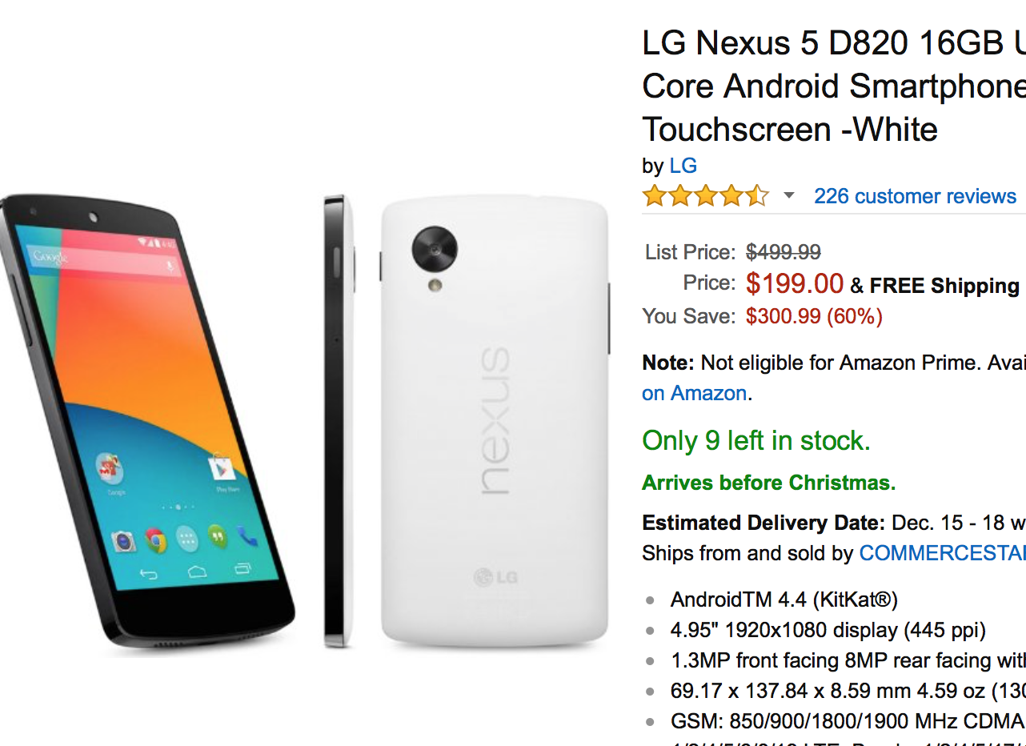
LG Nexus 5 – Amazon Review Data
226 reviews
(It might have changed since then)

